Slide 1


Analyzing Factors Affecting Steam Games Sales

Slide 2

MOTIVATION

Slide 3




To predict if a video game released on steam will have high, average or low level of ownership ( or sales )
To analyze the relationship of different factors which contribute to making a game popular on steam
Generating latest dataset by manually scraping relevant data from various sources like steam, steamspy and metacritic for our analysis
Use external data like PC gaming users, youtube stats ( like views and comments) to evaluate the impact on the video game industry

Slide 4

APPROACH

Slide 5



Data collection and preprocessing
Feature transformation and Exploratory Data Analysis
Data analysis
Collected data from steamspy, steam and metacritic
Data cleaning and dropping columns that are not required for the analysys
Handling null values
Handling outliers
Feature creation
Correlation between variables
K-means clustering
Ordinal regression to classify success of the games
Check assumptions of ordinal regression
Causal analysis

Slide 6

DATA SOURCES

Slide 7



SteamSpy
Metacritic
Pipeline
List of Games
Steam API
SteamSpy scraping
Metacritic scores
Collect the Game name and Steam application ID from steamspy
Scrape the details of the game using steam REST API using the collected games list
Example URL:
http://store.steampowered.com/api/appdetails/?appids=570
Collect unique details of the game by scraping the steamspy webpage with python and beautifulsoup
Finally collecting the metacritic critic and user scores for the games by generating the game URL and scraping the web page

Slide 8
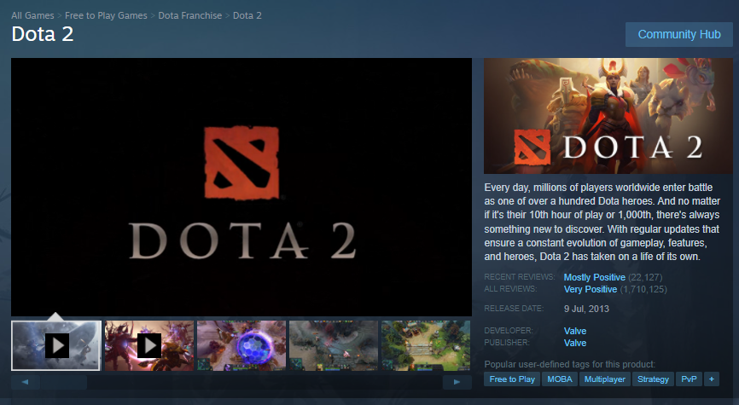
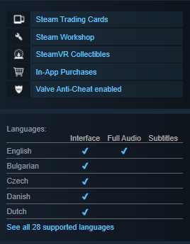


Steam Page

Slide 9

DATA CLEANING & PRE-PROCESSING

Slide 10
Data Cleaning and Pre-processing
DERIVED FEATURES
age ( age of the game) - Converted the published year into a new feature
Window_platfrom, Linux_platform, Mac_platform - the platform column is used to generate the three new features.
overall_positive_rating - the ratio of total positive ratings to total ratings
languages_supported - Used the supported_languages feature to the languages supported, if null it is at least supported by one language.
genre_list is encoded using sklearn MultiLabelBinarizer()
genre_count - Count of the number of genre
custom_user_score - Combination of metacritic user score and steam user review
Dropped textual features support_info, 'background, content_descriptors, package, package_groups
Remove the duplicate games using steam_appid
Total_owners in the data is a range, these ranges are converted into three categories which indicates high, average and low sales.
Drop the games that have total_ratings < 100
Total of 8729 rows for further analysis after data cleaning.

Slide 11

EXPLORATORY DATA ANALYSIS
Notes:
Reshma

Slide 12
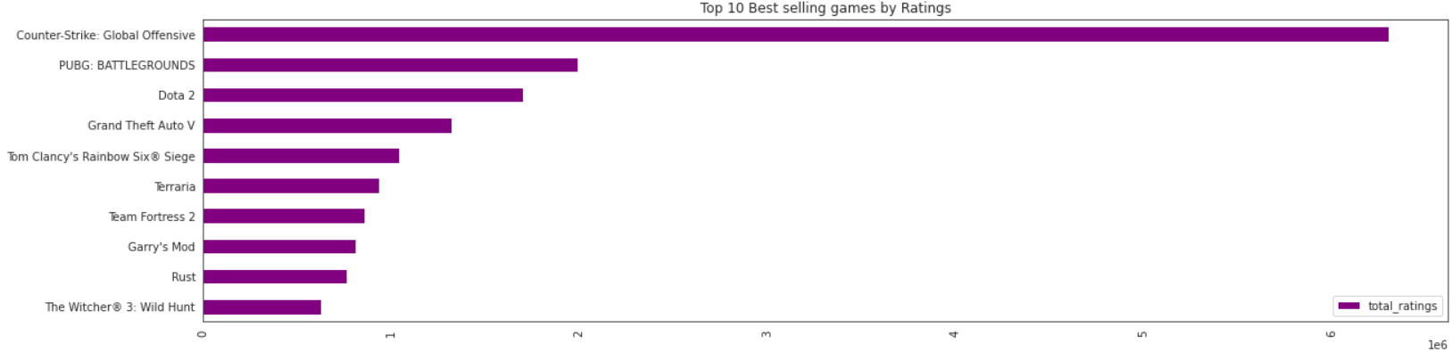
Counter-Strike, PUBG, Dota 2 rank at the top having the highest overall ratings

Slide 13
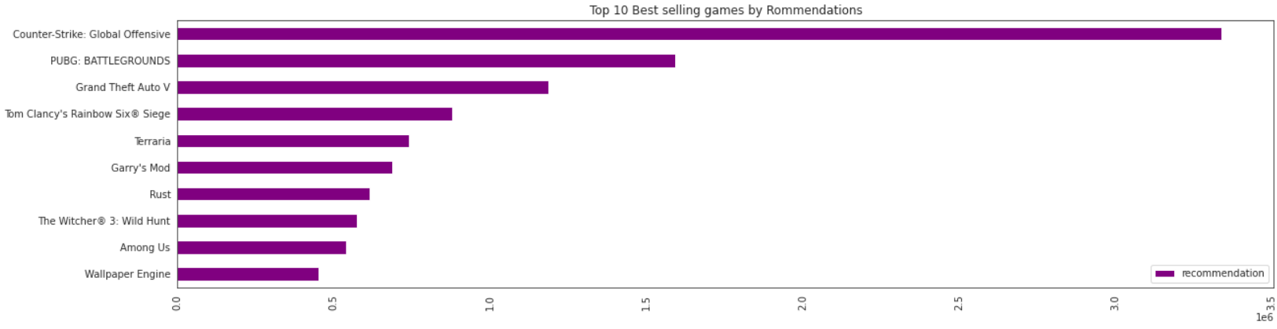
Counter-Strike, PUBG also rank highest in terms of top recommended games by players.

Slide 14
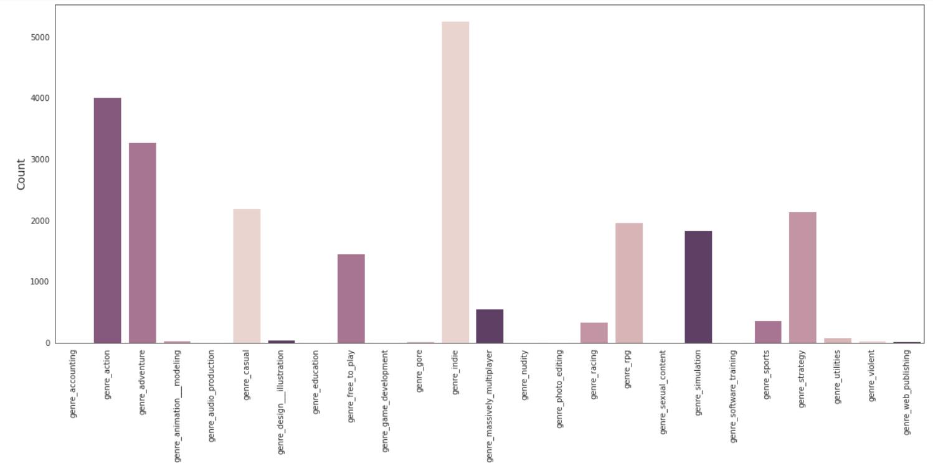
genre_indie
genre_action
Indie Genre is the top genre among all the games compared to other genres.
genre_adventure
Other top genres are Action and Adventure

Slide 15
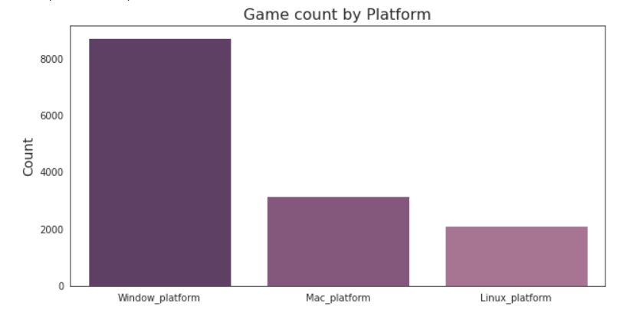
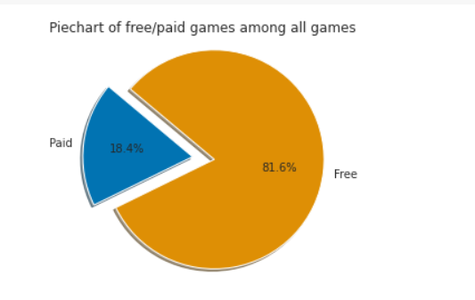
The most popular platform for games is Windows and least popular is Linux.
More than 80% games are free.
Very small percent of games are paid.

Slide 16
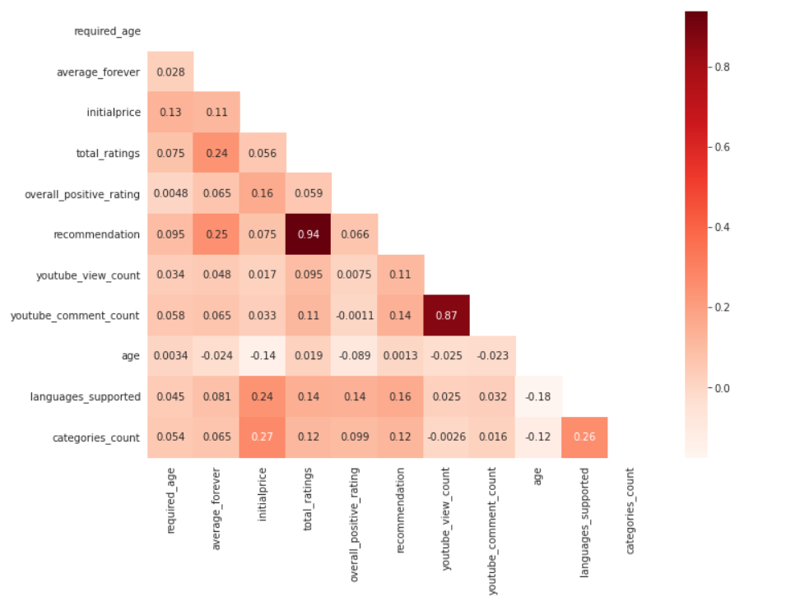
Heatmap - Correlation Matrix

Slide 17
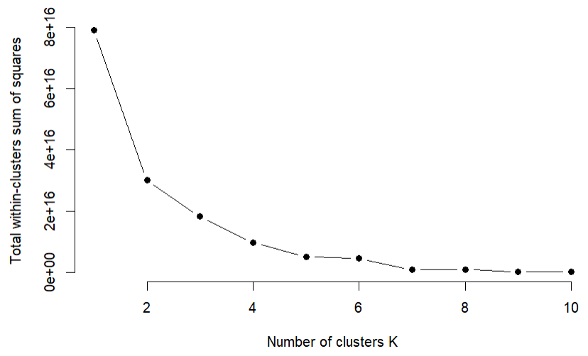
K-means Clustering
Analysing Elbow Graph
3 Clusters found based on Total_Owners

Slide 18
K-means Clustering
 | Cluster 1 | Cluster 2 | Cluster 3
initialprice | 3.95 | 47.44 | 19.71
overall_positive_rating | 7.57 | 8.05 | 8.21
languages_supported | 4.66 | 9.00 | 7.27
age | 6.30 | 3.61 | 5.21
average_forever | 0.00433 | 0.01587 | 0.00390
total_ratings | 0.00101 | 0.00462 | 0.00185

Slide 19

ORDINAL REGRESSION

Slide 20
Ordinal Regression
Dependent Variable: Created a new feature total_owners_category by clustering total no of owners into 3 categories : 0 ,1 and 2 with order 0<1<2
Category | Range (No of owners)
0 | 10000 - 150000
1 | 350000 - 3.5 Million
2 | 7.5 Million - 150 Million
Notes:
150000
3500000

Slide 21
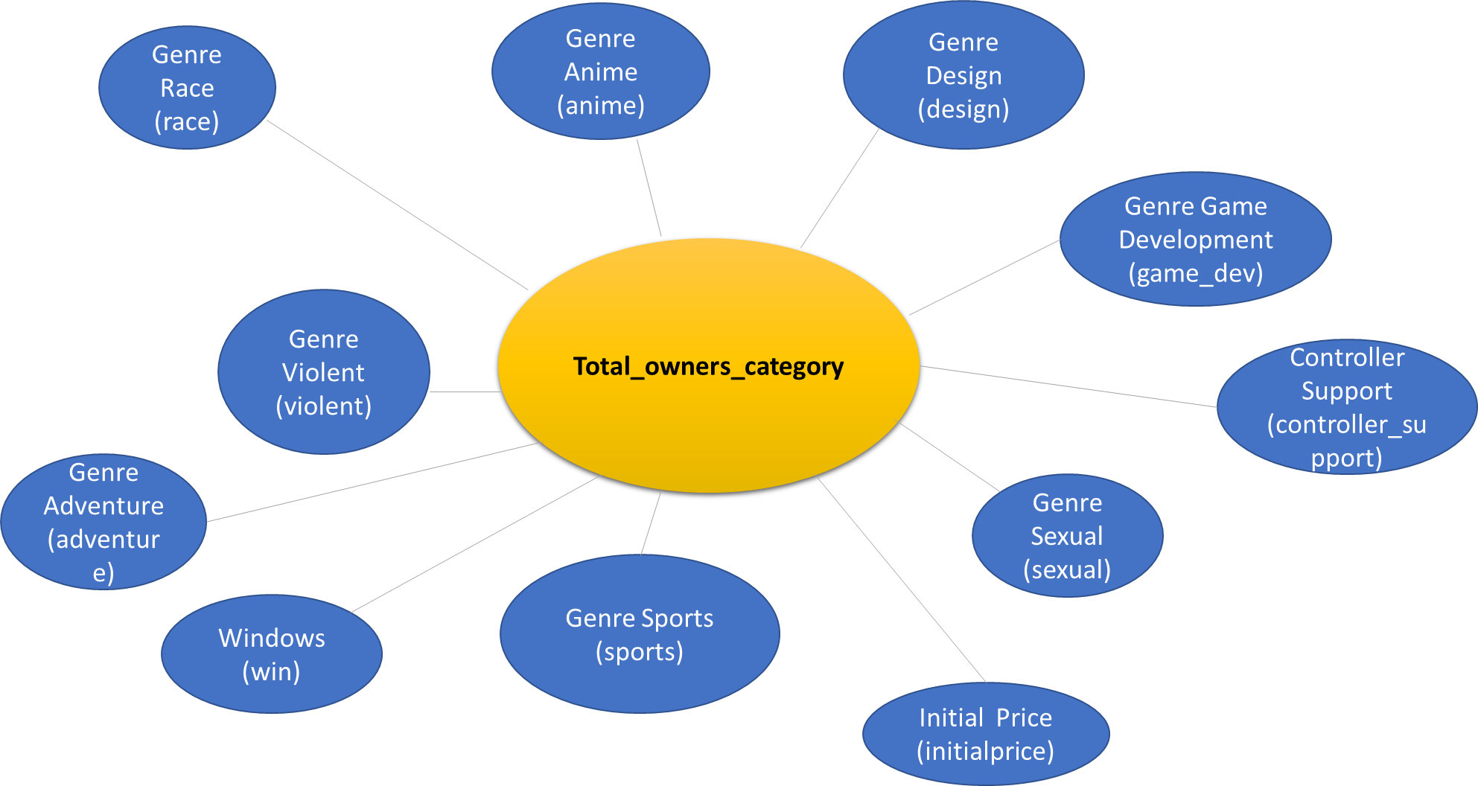
Variables

Slide 22



Hypothesis
H0: There is no statistically significant factors between variables that influence the total owner's category
H1: There is at least one statistically significant factor between the variables that influence the total owner's category

Slide 23
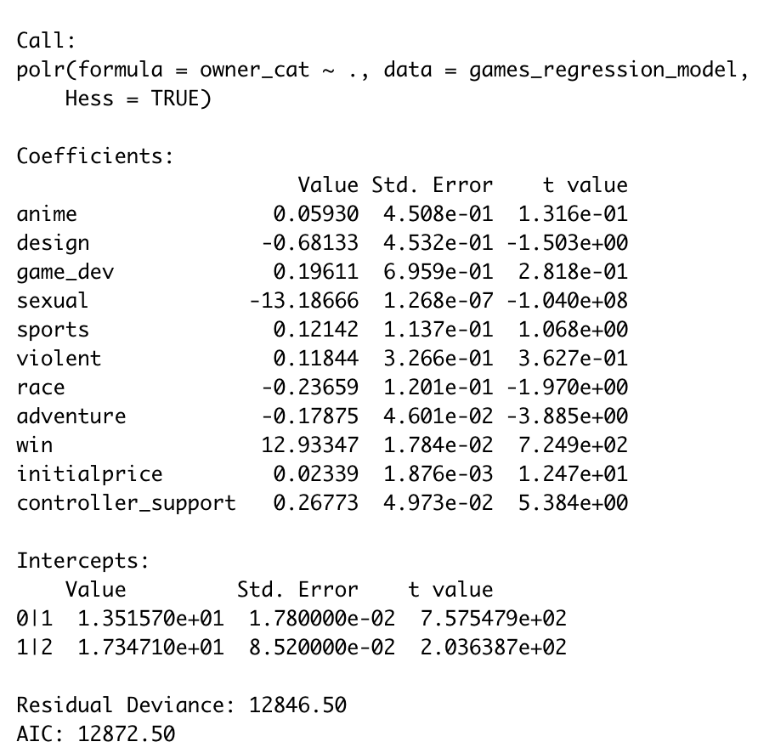
Result of Proportional Odds Logistic Regression

Slide 24
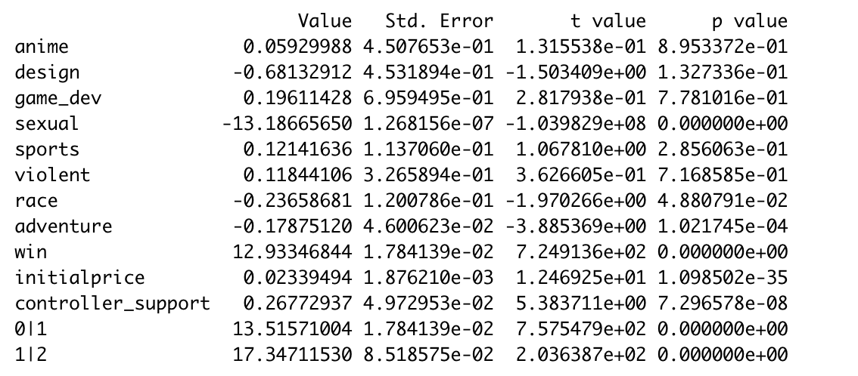
Result with p values
Since there is at least one variable that is statistically significant,
the null hypothesis (H0) is rejected
the alternative hypothesis (H1) is accepted.
Most Significant Features:
● Window Platforms
● Genre Sexual
● Genre Race
● Genre Adventure
● Price
● Controller Support
Notes:
Windows: A video game supported by windows platform as opposed to non windows platforms is associated with a higher likelihood of having more number of owners
The continuous variables initial price can be interpreted as : with one unit increase in initial price the log of odds of having higher number of users increases by 0.02

Slide 25
Assumptions
The dependent variable is ordered
One or more independent variables are either continuous, categorical or ordinal
No multicollinearity
Proportionality odds

Slide 26
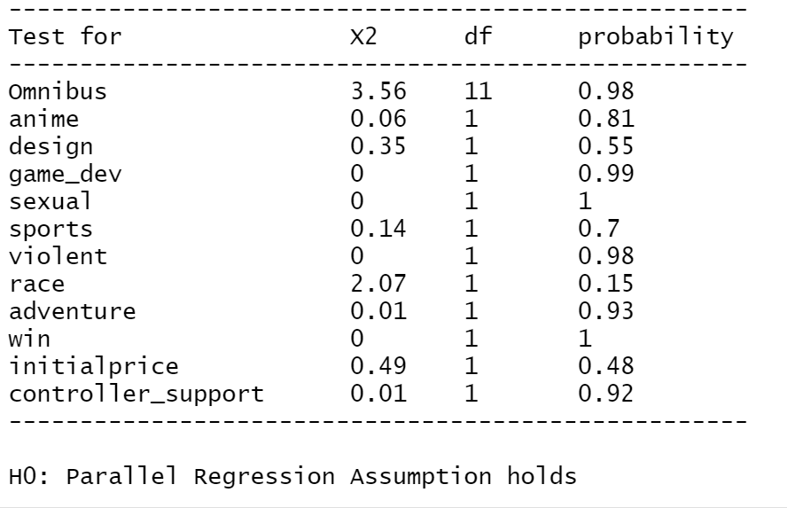
Brant Test : Test for Proportionality Odds
We conclude that the parallel assumption holds since the probability (p-values) for all variables are greater than alpha=0.05
The output also contains an Omnibus variable, which stands for the whole model, and it is still greater than 0.05.
Therefore the proportional odds assumption is not violated and the model is a valid model for this dataset

Slide 27

Thank You

